Slide 1
Computer Networks Network Address Translation and IPv6
Amitangshu Pal
Computer Science and Engineering
IIT Kanpur

Slide 2
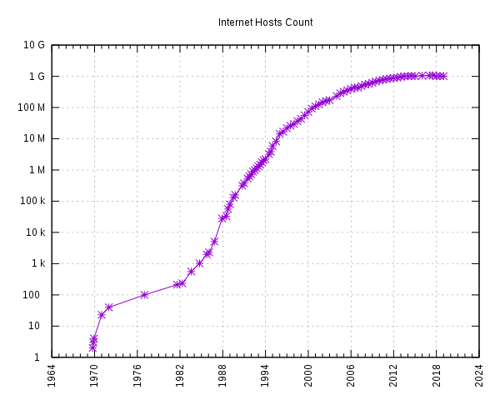
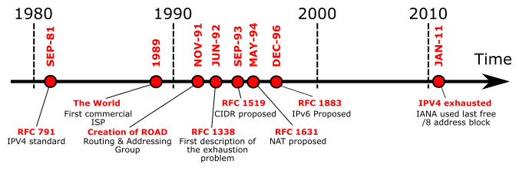
IPv4 Address Space Exhaustion
IPv4 address space is limited
Number of Internet users increased exponentially
NAT: Network Address Translation
IPv6 addressing
Src: https://commons.wikimedia.org/wiki/File:Internet_Hosts_Count_log.svg
Src: https://commons.wikimedia.org/wiki/File:IPv4_exhaustion_time_line-en.svg

Slide 3
Network Address Translation

Slide 4

NAT: Network Address Translation
Home network:
One access point has one IPv4 address
Suppose 10 hosts are connected to the access point
Rest of
Internet
Local network (e.g., home network)
138.76.29.7

Slide 5
Public and Private IP Address
Private IP address:
Can be reused
10.0.0.0 - 10.255.255.255
172.16.0.0 - 172.31.255.255
192.168.0.0 – 192.168.255.255
Public IP address:
Cannot be reused
Globally unique
Rest of
Internet
Local network (e.g., home network)
138.76.29.7

Slide 6
NAT: Network Address Translation
NAT: All devices in local network share just one IPv4 address as far as outside world is concerned
Rest of
Internet
Local network (e.g., home network) 10.0.0/24
138.76.29.7
10.0.0.4
10.0.0.1
10.0.0.2
10.0.0.3
All datagrams leaving local network have same source NAT IP address: 138.76.29.7, but different source port numbers
Datagrams with source or destination in this network have 10.0.0/24 address for source, destination (as usual)

Slide 7
NAT: Network Address Translation
NAT translation table
WAN side addr LAN side addr
2: NAT router changes datagram source address from 10.0.0.1, 3345 to 138.76.29.7, 5001,
updates table
1: host 10.0.0.1 sends datagram to 128.119.40.186, 80
138.76.29.7, 5001 10.0.0.1, 3345
…… ……
S: 10.0.0.1, 3345
D: 128.119.40.186, 80
1
10.0.0.1
2
S: 138.76.29.7, 5001
D: 128.119.40.186, 80
10.0.0.4
10.0.0.2
138.76.29.7
S: 128.119.40.186, 80
D: 10.0.0.1, 3345
4
S: 128.119.40.186, 80
D: 138.76.29.7, 5001
3
10.0.0.3
3: reply arrives, destination address: 138.76.29.7, 5001
More info: https://docs.aws.amazon.com/vpc/latest/userguide/vpc-nat-gateway.html

Slide 8
NAT: Network Address Translation
Implementation: NAT router must (transparently):
Outgoing datagrams: replace (source IP address, port #) of every outgoing datagram to (NAT IP address, new port #)
remote clients/servers will respond using (NAT IP address, new port #) as destination address
Remember (in NAT translation table) every (source IP address, port #) to (NAT IP address, new port #) translation pair
Incoming datagrams: replace (NAT IP address, new port #) in destination fields of every incoming datagram with corresponding (source IP address, port #) stored in NAT table

Slide 9
NAT Traversal Problem
Client wants to connect to server with address 10.0.0.1
Server address 10.0.0.1 local to LAN (client can’t use it as destination addr)
Only one externally visible NATed address: 138.76.29.7
10.0.0.1
client
?
10.0.0.4
138.76.29.7
NAT
router

Slide 10
NAT Traversal Problem
Solution 1: Universal Plug and Play (UPnP) Internet Gateway Device (IGD) Protocol. Allows NATed host to:
Learn public IP address (138.76.29.7)
Add/remove port mappings (with lease times)
10.0.0.1, 3345
IGD
NAT
router
Mapping:
10.0.0.1, 3345 to 138.76.29.7, 5001

Slide 11



NAT Traversal Problem
2. connection to
relay initiated
by client
1. connection to
relay initiated
by NATed host
10.0.0.1
client
3. relaying
established
138.76.29.7
NAT
router
Solution 2: Relaying (used in Skype)
NATed client establishes connection to relay
External client connects to relay
Relay bridges packets between to connections

Slide 12
NAT: Network Address Translation
Advantages:
Just one IP address needed from provider ISP for all devices
Can change addresses of host in local network without notifying outside world
Can change ISP without changing addresses of devices in local network
Security: devices inside local net not directly addressable, visible by outside world

Slide 13
NAT: Network Address Translation
NAT has been controversial:
Routers “should” only process up to layer 3
Violates end-to-end argument (port # manipulation by network-layer device)
But NAT is here to stay:
Extensively used in home and institutional nets, 4G/5G cellular nets

Slide 14
IPv6

Slide 15
IPv6 Motivation
Initial motivation: 32-bit IPv4 address space would be completely allocated
Additional motivation:
Speed processing/forwarding: 40-byte fixed length header
Enable different network-layer treatment of “flows”
IPv6 has a much larger address space (i.e. 128 bits)
Src: https://commons.wikimedia.org/wiki/File:Internet_Hosts_Count_log.svg

Slide 16
IPv6 Datagram Format
flow label: identify datagrams in same "flow.” (concept of “flow” not well defined).
priority: identify priority among datagrams in flow
32 bits
ver
pri
flow label
payload len
next hdr
hop limit
source address
(128 bits)
128-bit
IPv6 addresses
destination address
(128 bits)
payload (data)
Important features:
Flow levels for a group of packets
Better fit for advanced features (e.g. mobility, multicasting, security etc.)

Slide 17
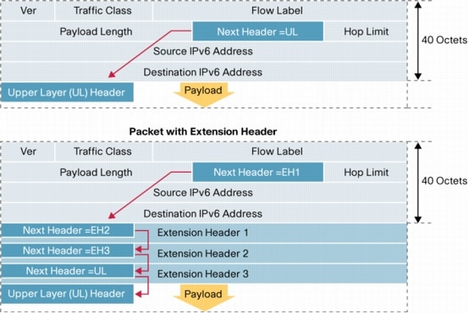
IPv6 Datagram Format
Extension headers
Next header field carries the information of the header following it
Src: https://www.cisco.com/en/US/technologies/tk648/tk872/technologies_white_paper0900aecd8054d37d.html

Slide 18
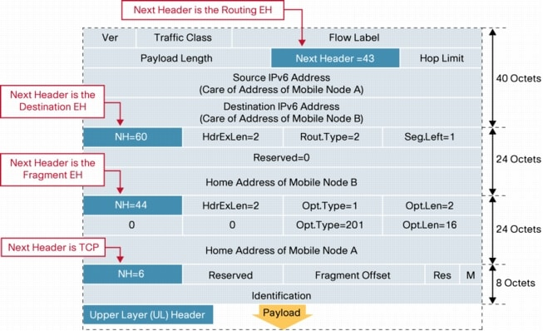
IPv6 Datagram Format
Order | Header Type | Next Header Code
1 | Basic IPv6 Header | -
2 | Hop-by-Hop Options | 0
3 | Destination Options | 60
4 | Routing Header | 43
5 | Fragment Header | 44
6 | Authentication Header | 51
7 | Encapsulation Security Payload Header | 50
8 | Destination Options | 60
9 | Mobility Header | 135
 | No next header | 59
Upper Layer | TCP | 6
Upper Layer | UDP | 17
Upper Layer | ICMPv6 | 58
Src: https://www.cisco.com/en/US/technologies/tk648/tk872/technologies_white_paper0900aecd8054d37d.html

Slide 19
IPv6 vs IPv4 Header
32 bits
32 bits
ver
pri
flow label
type of
service
payload len
next hdr
hop limit
ver
head.
len
length
source address
(128 bits)
16-bit identifier
flgs
fragment
offset
destination address
(128 bits)
time to
live
upper
layer
header
checksum
source IP address
payload (data)
destination IP address
options (if any)
What’s missing (compared with IPv4):
No checksum (to speed processing at routers)
No fragmentation/reassembly
No options (available as upper-layer, next-header protocol at router)
payload data
(variable length,
typically a TCP
or UDP segment)

Slide 20
IPv6 Addressing
IPv6 has a much larger address space (i.e. 128 bits)
Consists of 8 groups of 4 hex digits (i.e. 16 bits)
Can be written in compact format
Omit leading zeros
Omit groups of zeros
Example: 2001:0db8:0000:0000:0000:ff00:0042:b239

Slide 21
IPv6 Addressing
IPv6 has a much larger address space (i.e. 128 bits)
Consists of 8 groups of 4 hex digits (i.e. 16 bits)
Can be written in compact format
Omit leading zeros
Omit groups of zeros
Example: 2001:0db8:0000:0000:0000:ff00:0000:b239

Slide 22
IPv6 Addressing
IP addresses have structure:
Network part: devices in same network have common high order bits
Host part: remaining low order bits
Example: 2001:0db8:0000:0000:0000:ff00:0000:b239/64

Slide 23
Transition from IPv4 to IPv6
IPv6 is fundamentally different than IPv4
Not all routers can be upgraded simultaneously
How will the network operate with mixed IPv4 and IPv6 routers?
Well known approaches:
Dual stack (supports both IPv4 and IPv6)
Tunneling (carries IPv6 over IPv4)

Slide 24
Dual Stack IP Implementation
IPv4 Host
IPv4/IPv6 Host
IPv6 Host
Application
Application
Application
application
application
application
transport
transport
Transport
Transport
transport
Transport
IPv4
IPv4
IPv6
IPv6
Link
Link
link
Link
link
link

Slide 25
Tunneling and encapsulation
Tunneling: IPv6 datagram carried as payload in IPv4 datagram among IPv4 routers (“packet within a packet”)
Tunneling used extensively in other contexts (4G/5G)
IPv4 header fields
IPv6 header fields
IPv4 payload
IPv4 source, dest addr
IPv6 source dest addr
UDP/TCP payload
IPv6 datagram
IPv4 datagram

Slide 26
Tunneling and Encapsulation
IPv4 network connecting two IPv6 routers
A
B
E
F
IPv6
IPv6/v4
IPv6/v4
IPv6
IPv4 network
IPv4 tunnel connecting two IPv6 routers
A
B
IPv4 tunnel
connecting IPv6 routers
E
F
IPv6
IPv6/v4
IPv6/v4
IPv6
IPv6 datagram
IPv4 datagram
Tunneling: IPv6 datagram as payload in a IPv4 datagram

Slide 27
Tunneling
A
B
IPv4 tunnel
connecting IPv6 routers
E
F
Logical view:
IPv6
IPv6/v4
IPv6/v4
IPv6
A
B
C
D
E
F
Physical view:
IPv6
IPv6/v4
IPv4
IPv4
IPv6/v4
IPv6
flow: X
src: A
dest: F
data
src:B
dest: E
src:B
dest: E
src:B
dest: E
flow: X
src: A
dest: F
data
Flow: X
Src: A
Dest: F
data
Flow: X
Src: A
Dest: F
data
Flow: X
Src: A
Dest: F
data
Note source and destination addresses!
A-to-B:
IPv6
B-to-C:
IPv6 inside
IPv4
B-to-C:
IPv6 inside
IPv4
B-to-C:
IPv6 inside
IPv4
E-to-F:
IPv6

Slide 28
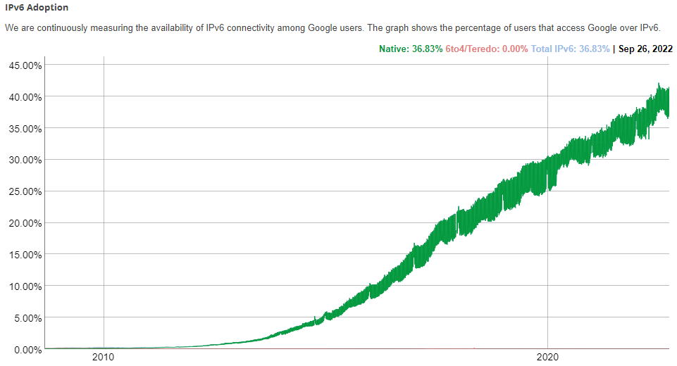
IPv6: Adoption
Google: ~40% of clients access services via IPv6 (Sep, 2022)
NIST: 1/3 of all US government domains are IPv6 capable
Src: https://www.google.com/intl/en/ipv6/statistics.html#tab=ipv6-adoption

Slide 29
Summary
Network Address Translation:
Helps IPv4 address space exhaustion
IPv6 Addressing:
IPv6 datagram format
Tunnelling and Encapsulation

